Slide 1
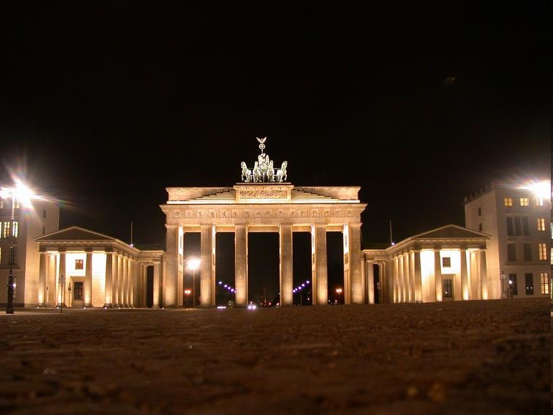

Multi-Valued Fields
In Condensed Matter, Electromagnetism, and Gravitation
Hagen Kleinert, FU BERLIN

Slide 2


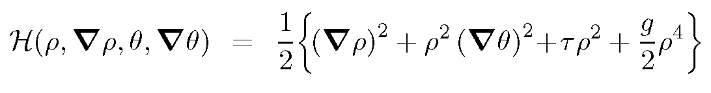
Why Multivalued Fields ?
Example: Ginzburg-Landau Theory
set
Chain Rule:
FALSE!

Slide 3
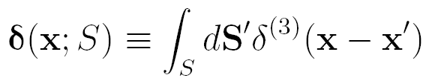
Indistinguishability
Correct Chain Rule:
In 1D, can be removed by going to covering group U(1)
In >1D impossible

Slide 4
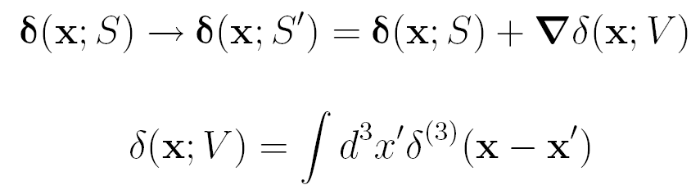


Gauge Transformations
Invariant:
Axial Gauge
No Go

Slide 5
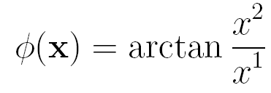
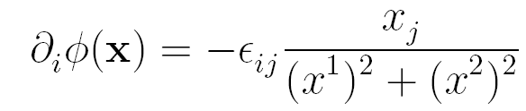
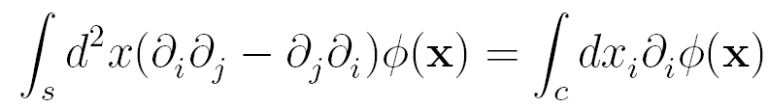
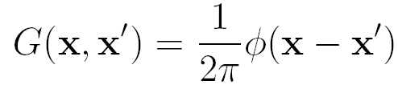


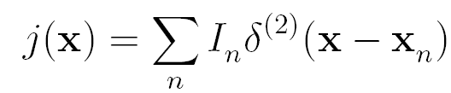
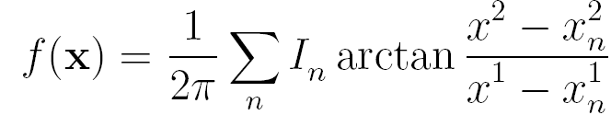
EXAMPLE FOR MULTIVALUED FIELD in 2D
Solve:

Slide 6
NOTE:
Mother of Two Green Functions

Slide 7




Example: Magnetostatics
Recall:

Slide 8


Now: Generate Magnetic Field by Multivalued Gauge Transformations

Slide 9

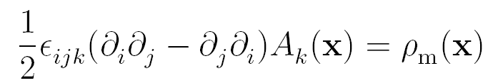
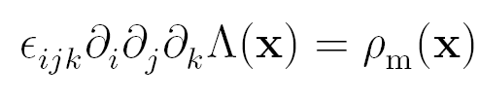
Magnetic Monopoles

Slide 10
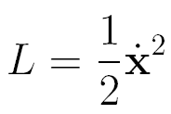








Minimal Coupling From Non-
holonomic Gauge Transformations
Then action changes by surface terms only:
For nonholonomic
Nontrivial

Slide 11
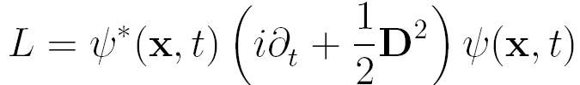





Schrödinger Equation
Momentum
Solved by
Use nonholonomic
then
with nonzero magnetic field

Slide 12
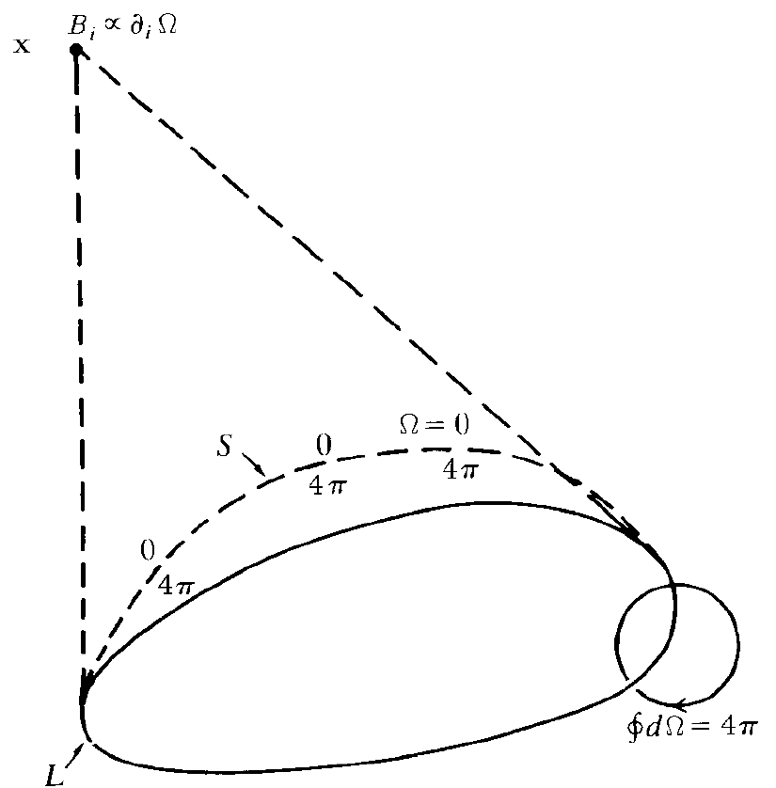
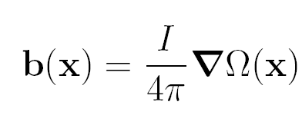
Multivalued Description of Magnetism
Magnetic Field

Slide 13
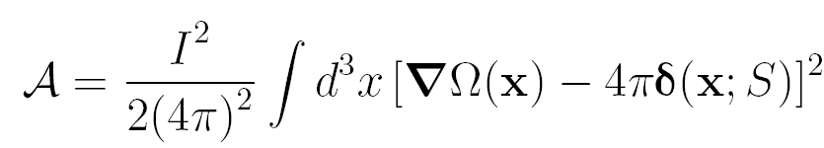
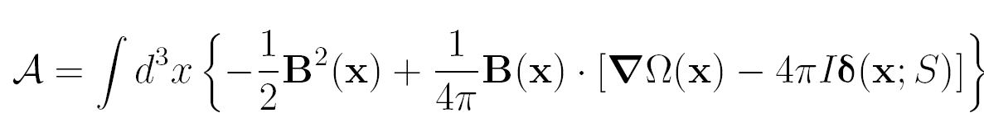
Action
Gauge Invariance

Slide 14
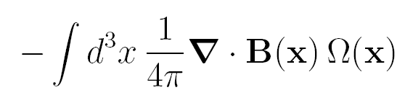


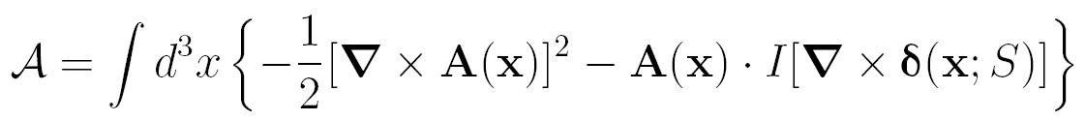




Integration by parts
Integration of Omega
Enforced as Bianchi Idty:
Double Gauge Theory:
Defect Current Conserv.:

Slide 15
action arises from
New Chain Rule
In London (hydrodynamic) Limit
Thus Formalism holds for superfluid helium!

Slide 16
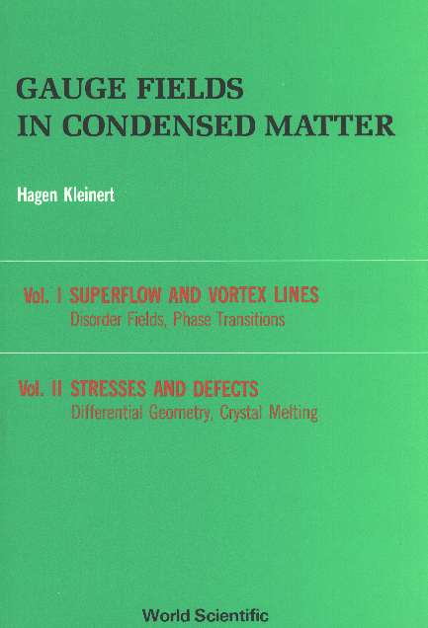
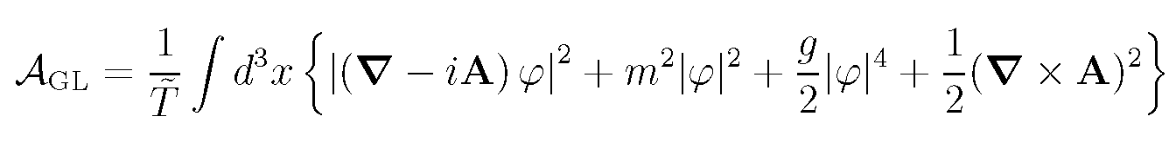
GC Sum Over Lines
can be transformed into
Disorder QFT
Result
Ginzburg-Landau Theory
of Superfluid Helium

Slide 17
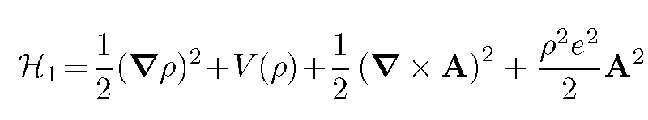
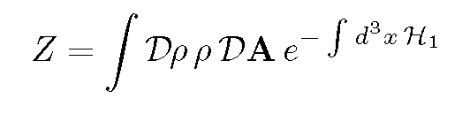
Order of Supercontucting Transition
in Ginzburg-Landau Theory
Simple argument:
)
Absorb phase angle (unitary gauge

Slide 18
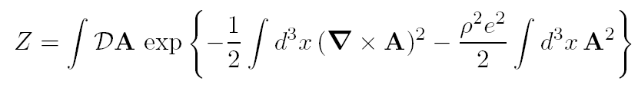
Integrated out cubic term 1st-order transtion:
Fluctuations of vector potential

Slide 19
Correct:

Slide 20
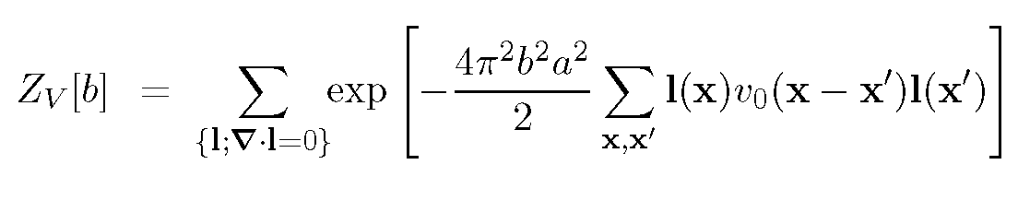
Villain Model

Slide 21
Relate to
Result
(recall
)
Confirmed by Monte Carlo

Slide 22

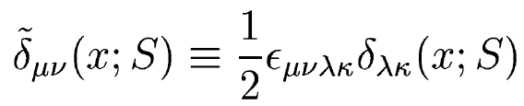
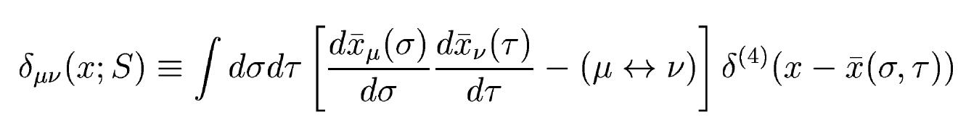
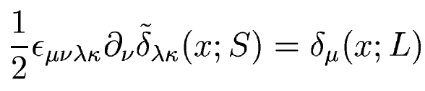
Double-Gauge QFT of Monopoles

Slide 23
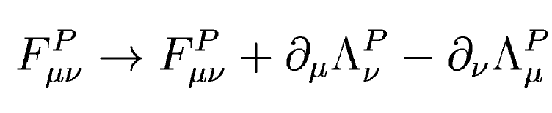
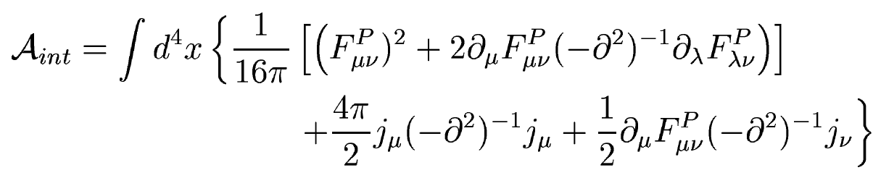
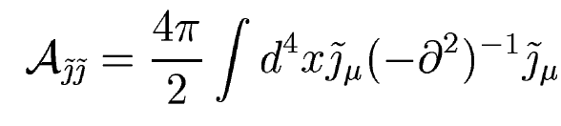
Changing the surface is gauge transformation

Slide 24



Monopole Gauge Invariance
Dirac QC:

Slide 25
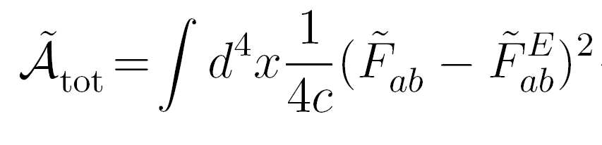
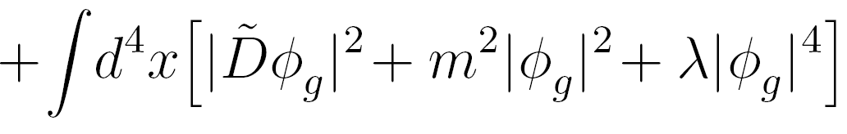
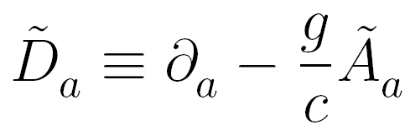
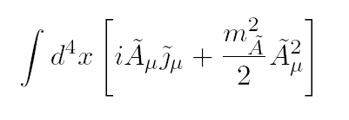

Quark Confinement
Exchange electric
magnetic
Disorder Theory of magnetic worldlines

Slide 26
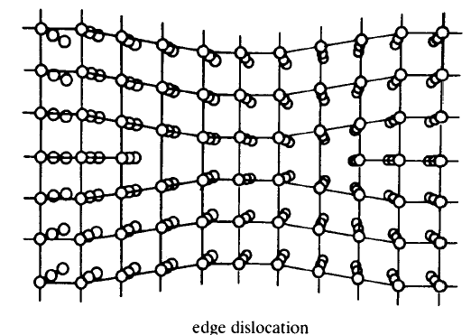
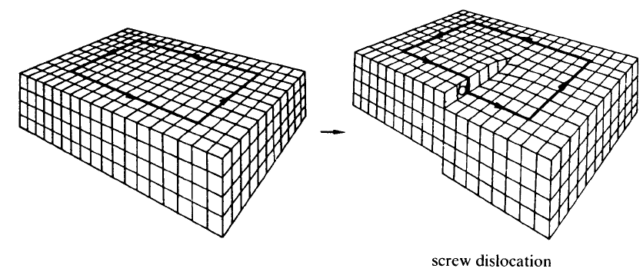
Nontrivial Geometry
from Nonholonomic Coordinate Transformations
Burgers vector b

Slide 27
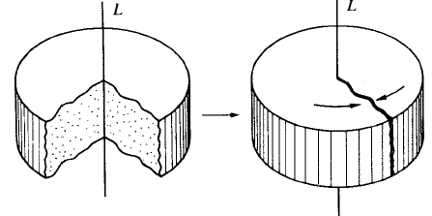
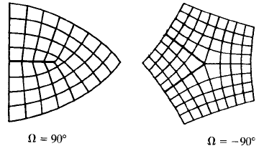
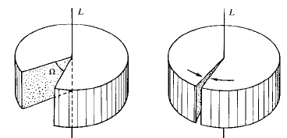

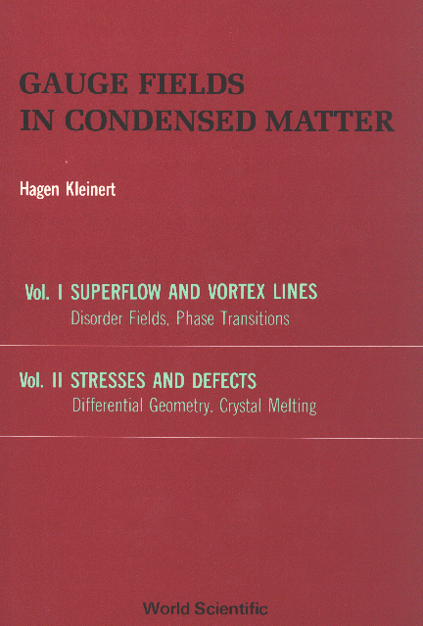
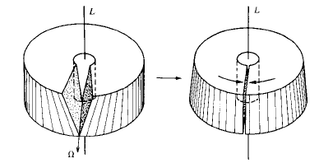
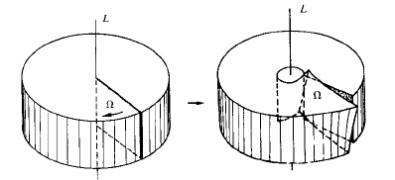
DISCLINATIONS
→
Frank Vector

Slide 28
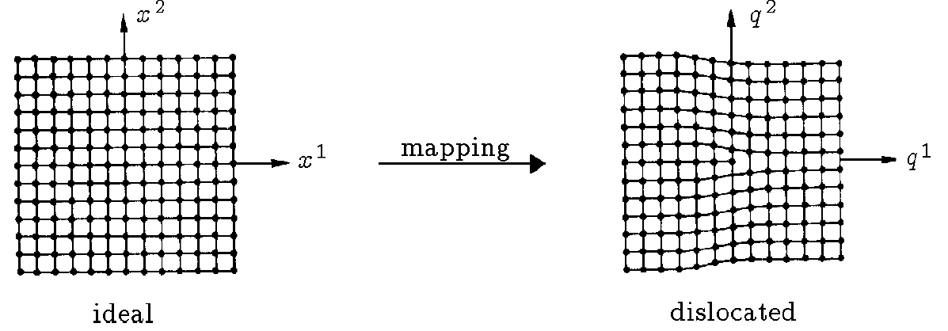
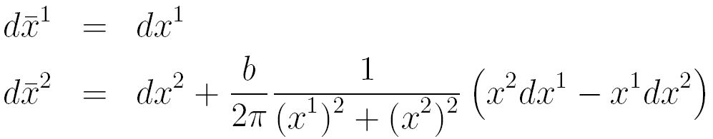
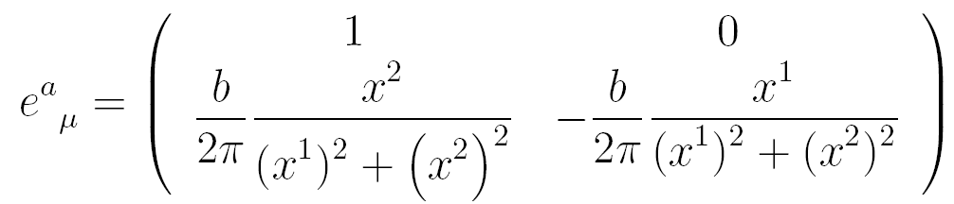

Slide 29
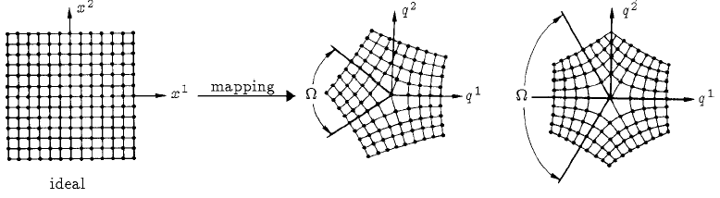

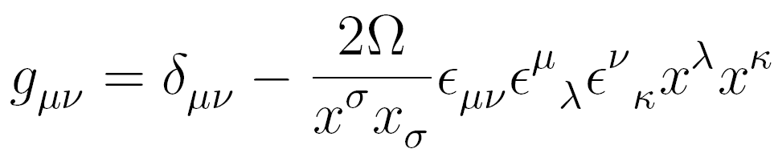

Slide 30

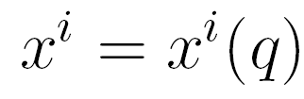




FUNDAMETALS:
Universality of FREE PARTICLE motion:

Slide 31
Nonholonomic image of
is Autoparallel
Instead of Geodesic

Slide 32










QUANTUM THEORY:
Trajectory is fat fluctuation sausage!
→ Tidal forces on wave packet
?

Slide 33




Lattice Defect Theory vs Abelian QED on Lattice
Lattice formulation
Define

Slide 34




CURIOSITY: Induced Gravity
Elastic Gauge Tfs:
Canonical Form
Momentum Conservation
Enforced as Bianchi Idty:
Double Gauge Theory

Slide 35







Dual Representation

Slide 36




BUT NEED

Slide 37

Modify Elastic Action to
and further to
FLOPPY CRYSTAL

Slide 38
THE END
Thanks to Axel and Wolfhard
If you want ot know more, read my new book
MULTIVALUED FIELDS

Slide 40











Volterra Construction
Conservation Laws
Define Einstein Tensor
Define Torsion
Linearized Bianchi Identity
Linearized Fundamental Identity

Slide 41











INTEGRABILITY CONDITIONS
Define Curvature Tensor:
Then above integrability implies:
(linearized Biachi identitiy)

Slide 42







General Coordinate Transformation
Basis Tetrads
Affine Connection

Slide 43






Multivalued Basis Tetrads

Slide 44

INTEGRABILITY CONDITIONS
Bianchi Identities

Slide 45



General , then Bianchi Identities
Rewrite as
Palatini tensor

Slide 46





Gravitational field version of conservation laws

Slide 47








Minimal Coupling from Nonholonomic Coord. Tranfs.
Holonomic vierbein
transforming to
nonholonomic
Coordinates

Slide 48





Multivalued infinitesimal coordinate transformation

Slide 49

INTEGRABILITY CONDITIONS
Bianchi Identities

Slide 50






Derivation from
Nonholonomic Mapping Principle for Dirac Electron
Flat Space
Local Lorentz Transformations

Slide 52




“ EXPERIMENTAL “ SITUATION
Hydrogen Atom in Momentum Space
Eliminates candidates

